Slide 1
Savings on Top Name Brands!
Earn Thousands of Dollars in One Single Day!
Jackson Music’s
4th Annual
New Mattress Fundraiser
Saturday, February 24th
10am – 5pm
@ Jackson High School
CFSbeds.com

Slide 2
Custom Fundraising Solutions
Who are we?
Locally Owned & Operated – Raised over $1.8 million for WA schools since 2014
Part of a Nationwide Fundraising Organization with 95 Locations Across the Country – Raised over $60 million for schools across the country since 2005
What programs/locations do we work with?
40+ events locally each year
Any given weekend you can find us at a local high school running this event
Reputation
Customer service is key to our success
Doing what we say we are going to do is what separates us from other companies and allows us back into your community year after year
CFSbeds.com

Slide 3
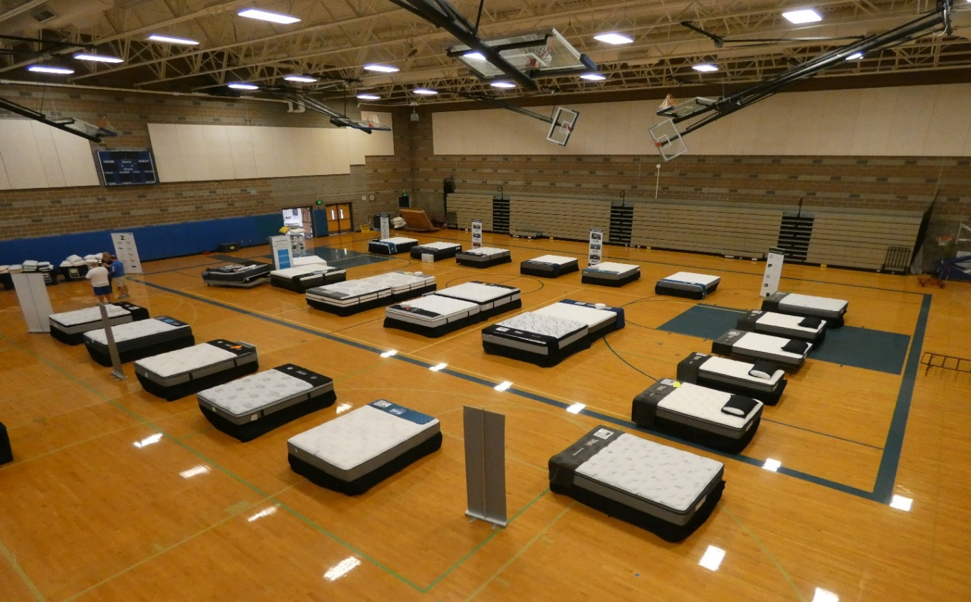
Showroom
30 Different Models
Twin (starting at $249),
Full (starting at $259),
Queen (starting at $299),
King (starting at $499),
CalKing (starting at $499)
Manufacturers we carry:
Simmons Beautyrest
Therapedic
Englander
Southerland
Tranquility
Wellsville
Intellibed
Payment options:
Credit
Cash
Check
Financing
Layaway
CFSbeds.com

Slide 4
Why Mattresses?
1 out of every 10 buy a new mattress each year!
We sell the same product someone can get in a store but for less!
Mattresses
Foundations / Boxsprings
Adjustable Bed Frames
Frames
We offer the same services stores do:
Warranties
Comfort Guarantees
Delivery & Haulaway Options
Great Customer
Competitive pricing AND your group makes between 45 – 60% of the net profits
Mattress Protectors
Luxury Pillows
Sheets
CFSbeds.com

Slide 5
Participation
All fundraising takes action!
Unlike with other fundraisers, participation in this fundraiser does NOT mean that you need to buy something!
Participation in this event means taking on the responsibility to get just one person in the market for a new bed to the event!
CFSbeds.com

Slide 6
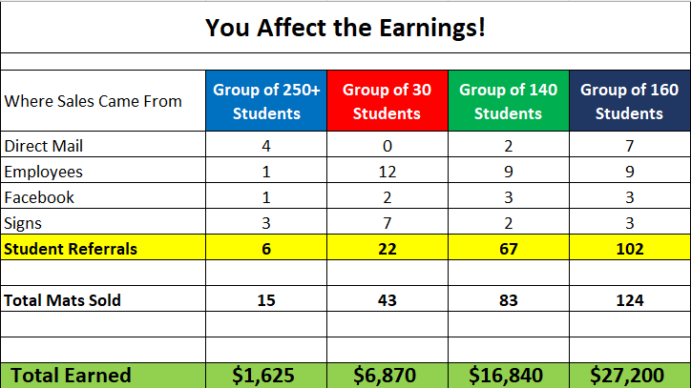
Student / Family Referrals Make All the Difference Between Success & Failure!
CFSbeds.com

Slide 7
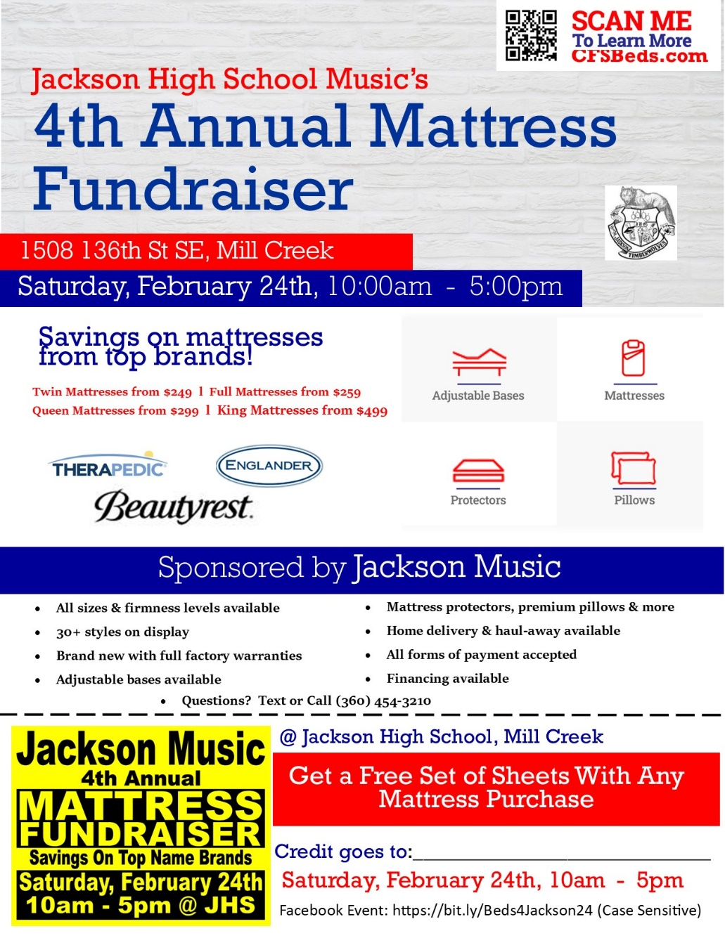
2024 Goal
Every family finds one person in the market for a new mattress and gets them to the event
250 students/referrals
= $55,000+

Slide 8
Find Your One & Make a Difference!!
Take a picture of your student’s referral flyer and text it to everyone you know
Go to the Facebook event & indicated that you’re “Going”, then share it with all your Friends
Post the referral flyer on ALL social media platforms that you utilize
Put a referral flyer up at your office
Parents
Friends
Neighbors
Brothers
Sisters
Cousins
Aunts
Uncles
Coworkers
Church Members
97% of text messages get open and read. HUGE opportunity to reach a large amount of people!

Slide 9
##1 Thing you can do…
How’d you sleep
last night?
Talk to Everyone You Know!

Slide 10
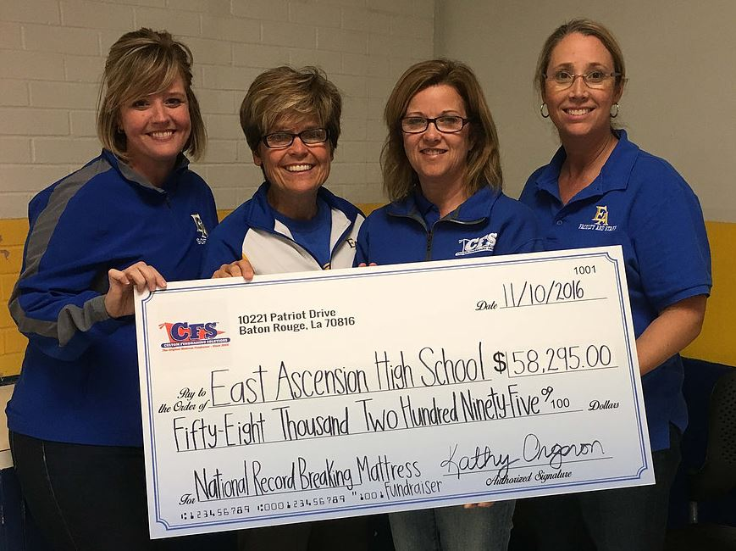
How Big Will Jackson’s Check Be?

